Slide 1
Number Theory and Cryptography
Ronny Mokaya,
SCT211-0200/2021

Slide 2
1 Divisibility and Modular Arithmetic
Divisibility
Definition: Integer a divides b (denoted a | b) if there exists an integer c such that b = ac.
Basic Properties:
If a | b and a | c, then a | (b + c).
If a | b, then a | bc.
If a | b and b | c, then a | c.
Eg: 3 | 12 because 12 = 3 × 4.
THE DIVISION ALGORITHM Let a be an integer and d a positive integer. Then there are unique integers q and r, with 0 ≤ r < d, such that a = dq + r.
Modular Arithmetic
Definition: Arithmetic system for integers where numbers "wrap around" after reaching a modulus m.
It operates on remainders modulo a fixed integer m.
Application:
Used in hashing, memory addressing, and cryptography.
Notation: a ≡ b (mod m) if m | (a - b).
17 ≡ 5 (mod 12) because 17 - 5 = 12.

Slide 3
2. Integer Representations and Algorithms
Representing Integers
Integers can be expressed in base-b (e.g., binary, octal, hexadecimal).
Conversion Algorithm: Divide integer by base and record remainders.
Arithmetic Algorithms
Addition, subtraction, and multiplication using base-b representation.
Modular Exponentiation:
Fast exponentiation using binary method.
Reduces time and space complexity.

Slide 4
3. Primes and Greatest Common Divisors
Prime Numbers
A number is prime if it has exactly two positive divisors: 1 and itself.
Fundamental Theorem of Arithmetic: Every integer >1 has a unique prime factorization. (they can be uniquely expressed as a product of primes)
GCD and Euclidean Algorithm
GCD of a and b is the largest integer dividing both.
Euclidean Algorithm: Efficient method for finding GCD. It uses repeated division and stops when remainder is 0.
Extended Euclidean Algorithm
Finds integers x, y such that ax + by = gcd(a, b).
Useful in finding modular inverses used in cryptography.

Slide 5
Solving Congruences
Solving linear congruences, which have the form ax ≡ b (mod m), is an essential task in the study of number theory and its applications, just as solving linear equations plays an important role in calculus and linear algebra.
To solve linear congruences, we employ inverses modulo m.

Slide 6
4. Solving Congruences
Linear Congruence
This is an equation of the form ax ≡ b (mod m).
Has a solution if and only if gcd(a, m) divides b.
When a solution exists, there are solutions modulo m.
Modular Inverses
The inverse of a mod m exists and is unique if and only if gcd(a, m) = 1.
It is found using the extended Euclidean algorithm.

Slide 7
4. Solving Congruences
Chinese Remainder Theorem (CRT)
This solves systems of simultaneous congruences with pairwise coprime moduli.
It also guarantees a unique solution modulo
Fermat’s Little Theorem
If p is prime and p ∤ a, then a^(p−1) ≡ 1 (mod p).
Foundation for primality tests and cryptographic algorithms.

Slide 8
5. Application of Congruence
1: Pseudorandom Number Generation
2: Hashing and Memory Addressing
3: Check Digits
Uses modular arithmetic to simulate randomness using Linear Congruential Generators (LCGs)
Use modulus operation to map data to fixed-size values.
Prevents data collisions and speeds up lookups.
Used to detect errors in data entry (e.g., credit cards, ISBNs).
Check digit is computed using modular arithmetic.
Example: ISBN-10 uses modulus 11 to validate number integrity.

Slide 9
Cryptography
Number theory plays a key role in cryptography, the subject of transforming information so that it cannot be easily recovered without special knowledge. Number theory is the basis of many classical ciphers, ﬁrst used thousands of years ago.
These ciphers encrypt messages by changing each letter to a diﬀerent letter, or each block of letters to a diﬀerent block of letters

Slide 10

6. Cryptography
Classical Cryptography
Caesar Cipher: Shifts letters by fixed positions; example of a substitution cipher.
Shift Cipher: General form of Caesar cipher; key is shift amount.
Vulnerability: Susceptible to frequency analysis and brute force.

Slide 11
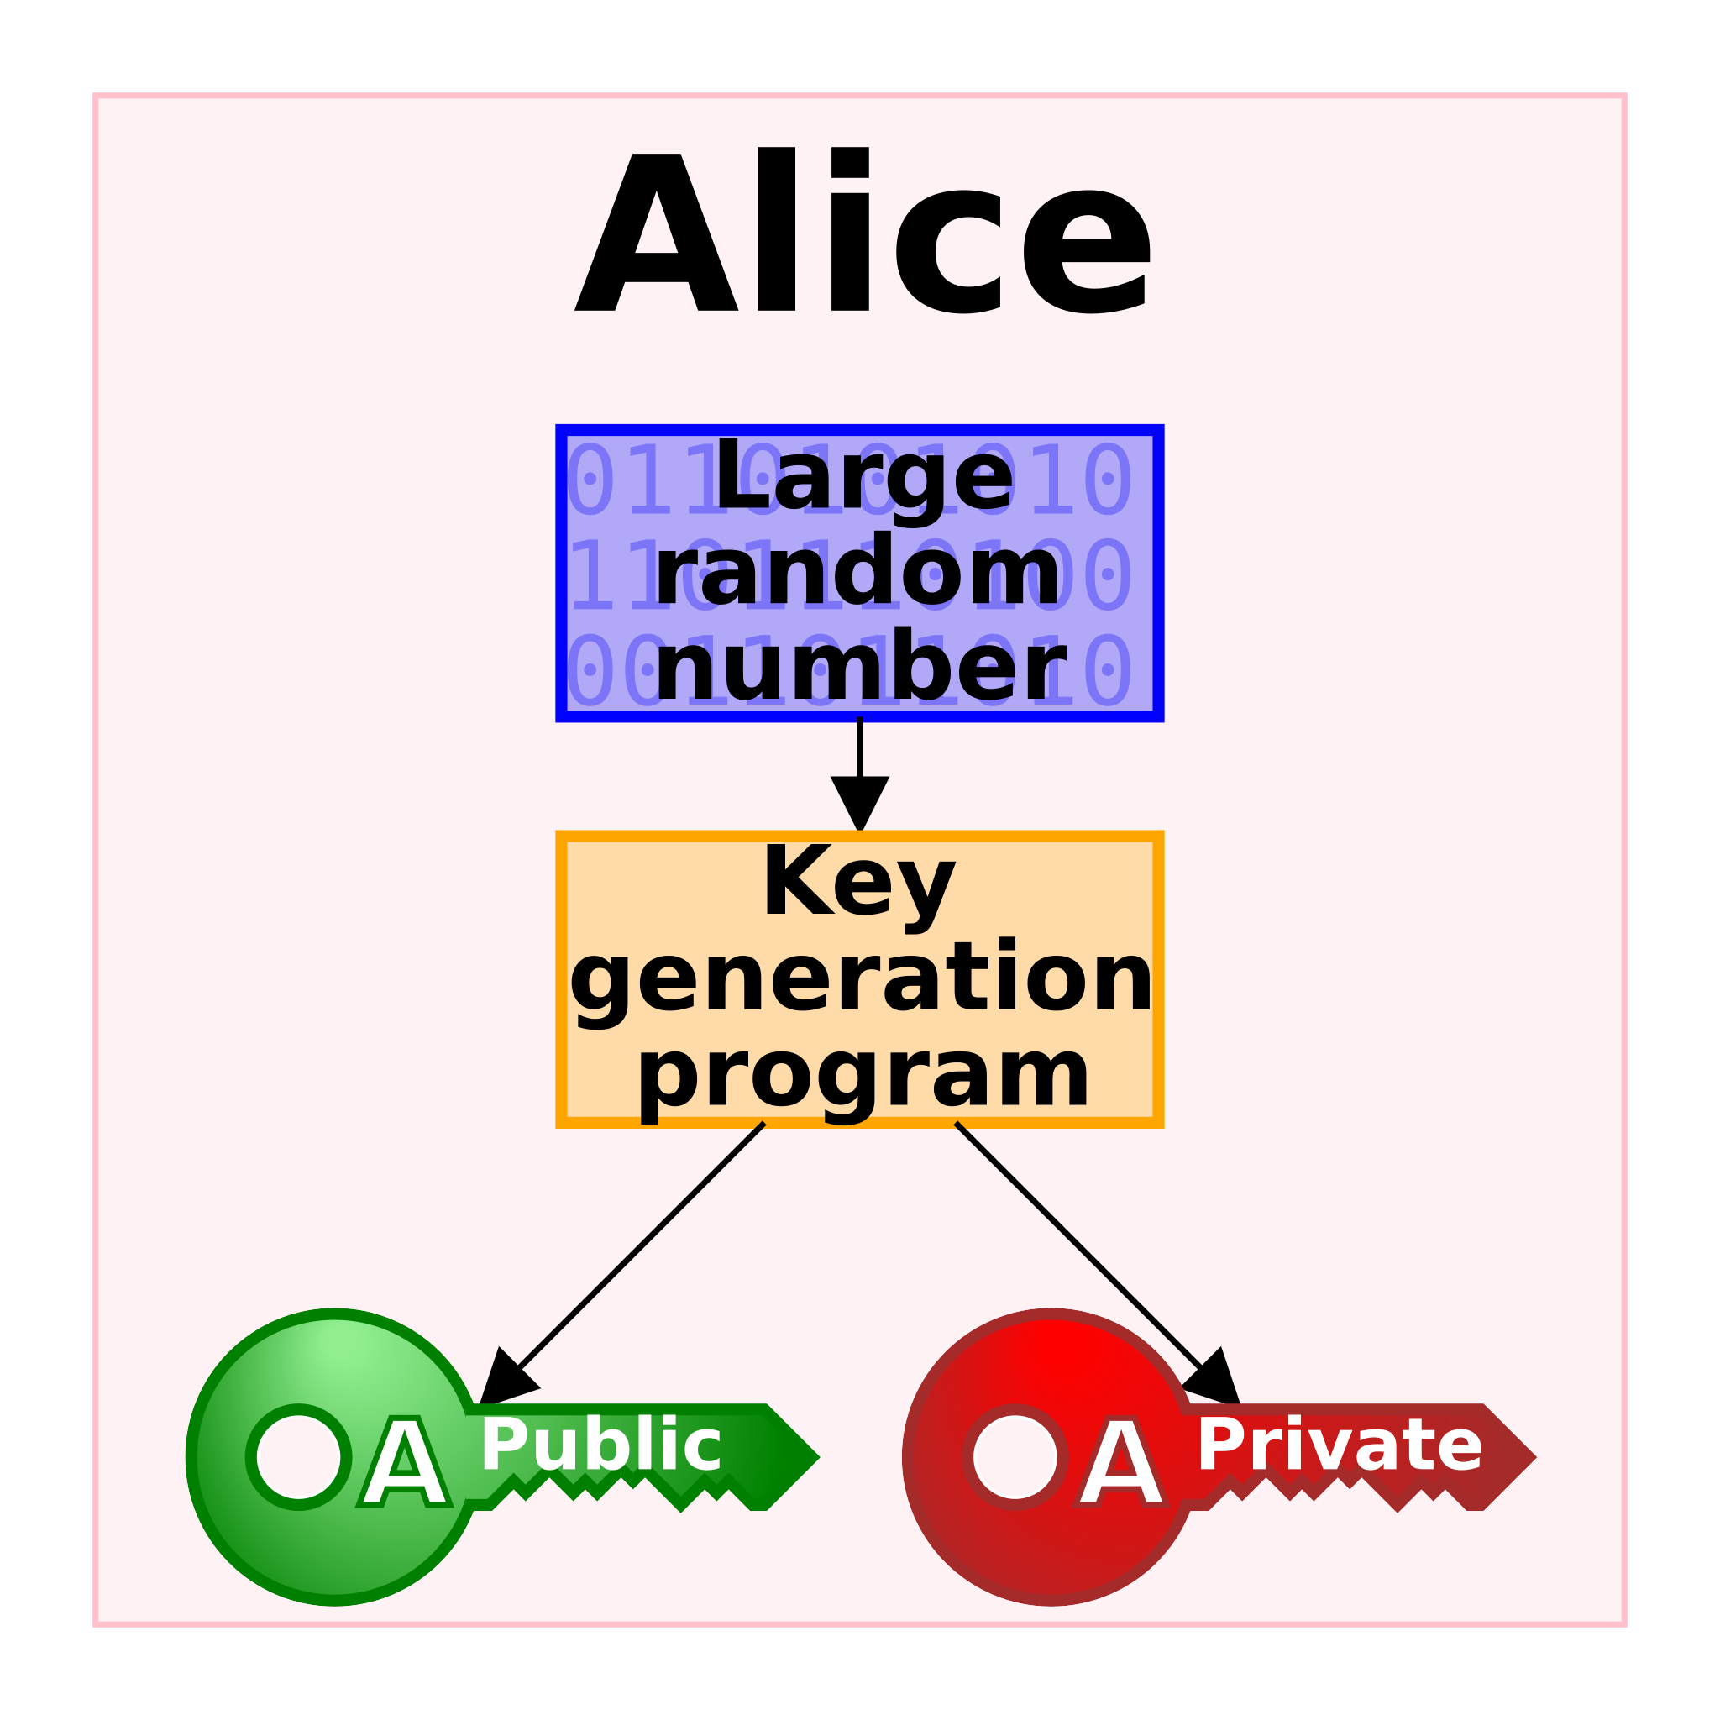
6. Cryptography
Public Key Cryptography (RSA)
Based on modular exponentiation and large prime factorization.
Encryption key is public; decryption requires private key (prime factors).
Secure under assumption that factoring large numbers is hard.

Slide 12

6. Cryptography
Cryptographic Protocols
Key Exchange (Diffie-Hellman): Allows two parties to securely share a secret.
Digital Signatures: Ensures authenticity of sender and integrity of message.

Slide 13

6. Cryptography
Homomorphic Encryption
Allows computations on encrypted data without decryption.
Important in secure cloud computing.

Slide 14
Thank you

